Slide 1
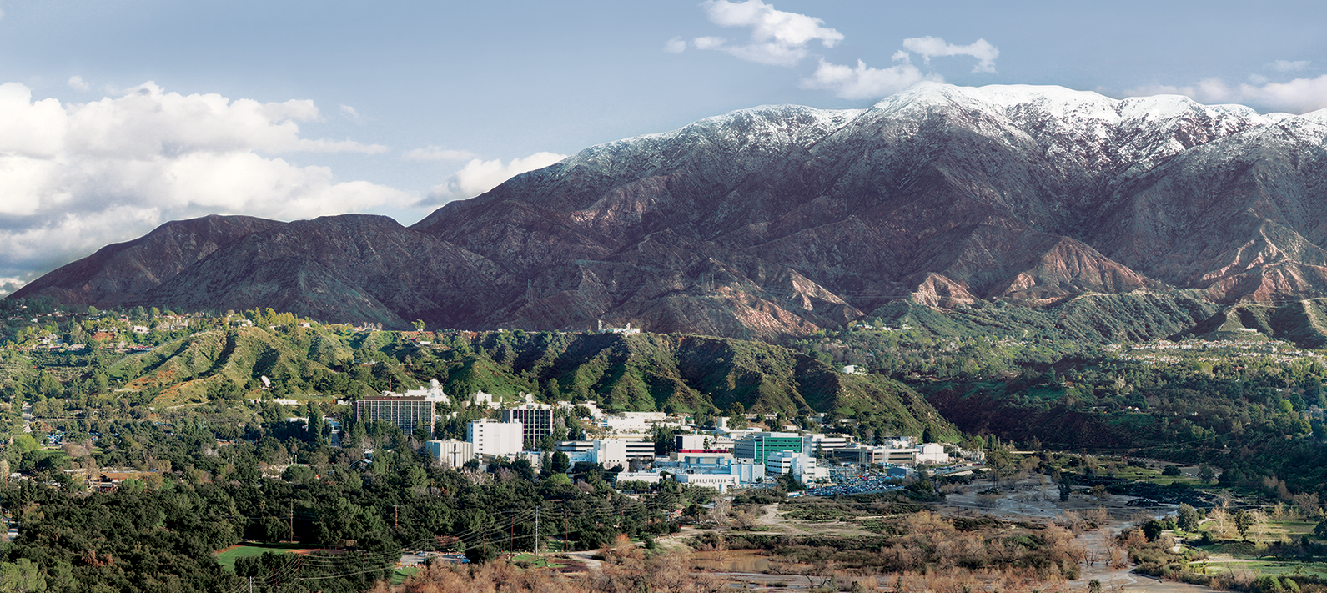
DRAT: An Unobtrusive, Scalable Approach to Large Scale Software License Analysis
Chris A. Mattmann, Ji-Hyun Oh, Tyler Palsulich, Lewis John McGibbney, Yolanda Gil and Varun Ratnakar
The Fourth International Workshop on Software Mining
30th IEEE/ACM International Conference on Automated Software Engineering
Tuesday 10th November, 2015, Lincoln, Nebraska, US

Slide 2
So what are we covering???
Motivation… analysis of software licenses and why it matters
Software release management; a tale from the Apache Incubator Project
RAT; a Release Audit Tool
Approaching large scale software license analysis; DARPA XDATA case study
DRAT; the Distributed Release Audit Tool
Demo
Other experiments and evaluations
Conclusion, recap and future work

Slide 3
Motivation… analysis of software licenses
Previous work (as detailed in proceedings)
We’ve seen an astronomical increase in the number of open source projects hosted in public repositories across many domains. As such the license of open source software becomes critical to grant everyone legally appropriate permission to freely use, modify, and distribute the open source software
There exist more than 60 licenses, such as Berkeley Software Distribution (BSD), General Public License (GPL), MIT license, the Apache License, version 2 (“ALv2”), and so on, approved by Open Source Initiative (OSI) for complying with open source definition, however, there exist slight differences among these Licenses
Circumstances are more complicated when people publish software under the multiple licenses. Therefore, an automated tool for verifying software licenses in code bases is highly desired.
…etc

Slide 4
Licensing for Release Management
A tale from the Apache Incubator Project
Each review item in this list is either required by Foundation-wide policy and would block a release by any Apache top-level project, or is required by Incubator policy.
1.1 Checksums and PGP signatures are valid. See the Release Signing dev documentation.
2.1 Build is successful including automated tests. The expanded source archive is expected to build and pass tests.
3.1 DISCLAIMER is correct, filenames include "incubating". See the Podling Branding Guide.
3.2 Top-level LICENSE and NOTICE are correct for each distribution. See the Licensing How-To, plus various pages under Legal Affairs.
3.3 All source files have license headers where appropriate. See the ASF Source Header and Copyright Notice Policy.
http://incubator.apache.org/guides/releasemanagement.html#check-list

Slide 5
Licensing for Release Management Cont’d
3.4 The provenance of all source files is clear (ASF or software grants). See the IP clearance section of the Mentor's guide, as well as the Releases section of the Incubator's policy page.
3.5 Dependencies licenses are ok as per http://apache.org/legal/ See ASF Legal Previously Asked Questions.
3.6 Release consists of source code only, no binaries. Each Apache release must contain a source package. This package may not contain compiled components (such as "jar" files) because compiled components are not open source, even if they were built from open source.
Good news though, tools DO exist for automating some of this workflow!

Slide 6

Queue Apache RAT
A Release Audit Tool
As part of the Apache Software Foundation (ASF) project, Apache Creadur, a Release Audit Tool (RAT) was developed especially in response to demand from the Apache Incubator and its dozens of projects. All codes donated from
individuals or organizations to ASF should go through the Apache Incubator as an entry path. The Apache Incubator ensures that the software has correct open source licenses.
Therefore, the primary function of the RAT is automated code auditing and open-source license analysis focusing on headers. RAT is a natural language processing tool written in Java to easily run on any platform and to audit code from many source languages (e.g., C, C++, Java, Python, etc.). RAT can also be used to add license headers to codes that are not licensed

Slide 7
Large Scale Software Licensing Analysis
Software Licensing for DARPA XDATA
In the summer of 2013, our team ran Apache RAT on source code produced from the Defense Advanced Research Projects Agency (DARPA) XDATA national initiative whose inception coincided with the 2012 U.S. Presidential Initiative in Big Data . XDATA brought together 24 performers across academia, private industry and the government to construct analytics, visualizations, and open source software mash-ups that were transitioned into government projects and to the defense sector. XDATA produced a large Git repository consisting of ~50,000 files and 10s of millions of lines of code.
All XDATA software is open source and is ingested into DARPA’s Open Catalog that points to outputs of the program including its source code and metrics on the repository. Because of this, one of core products of XDATA is the internal Git repository. Since XDATA brought together open source software across multiple performers, having an understanding of the licenses that the source codes used, and their compatibilities and differences was extremely important and since there repository was so large, our strategy was to develop an automated process using Apache RAT.

Slide 8
Large Scale Software Licensing Analysis Cont’d
Please check out Chris Mattmann’s Youtube video on DRAT explaining DRAT's motivation, and results of running it on DARPA XDATA and on the Computational Infrastructure for Geodynamics as part of a previous NSF project.
The video was made for the 2014 Summer Earth Science Information Partners Federation Meeting however provides excellent background context and quantified justification for development and use of DRAT on large codebases/repositories similar to those discussed here.
https://www.youtube.com/watch?v=9w3fpnNWdIE
Lets take a look at what DRAT is in some more detail to understand how we can analyze source code at scale!

Slide 9
DRAT Architecture
DRAT is a MapReduce (M/R) style RAT workflow that runs on top of Apache Object Oriented Data Technology (OODT), a scientific data processing, acquisition, and dissemination system. M/R, a methodology for processing a large amount of unstructured data with a parallel, distributed algorithm, consists of two components: “mapper” and “reducer”. The map procedure takes an input files and generates a set of intermediate outputs. The reduce procedure, in turn, consolidates all the intermediate results from the mapper into one final result. In DRAT, the “mapper” is RAT, and the “reducer” is a log collector to combine all the intermediate outputs into a global RAT report that can be used for stats generation.

Slide 10
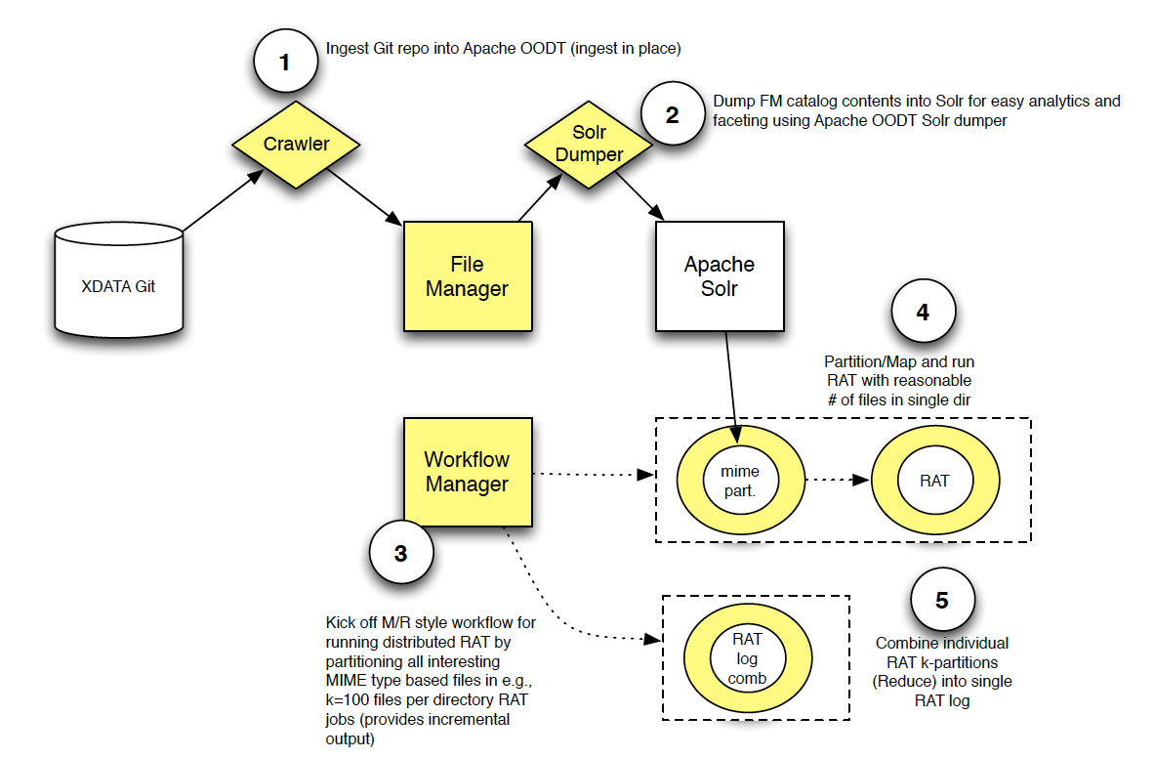

Slide 11
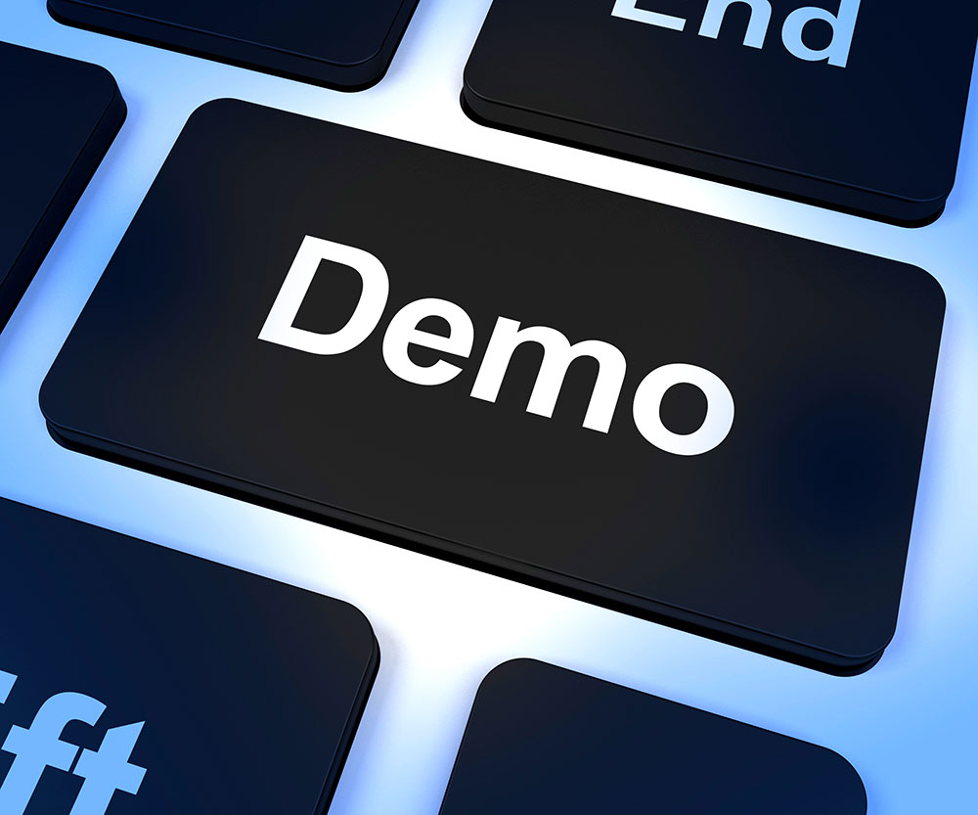

Slide 12
Other Experiments and Evaluation
Completed:
XNET Analysis… please see workshop proceedings and Chris Mattmann’s YouTube video
DRAT used pervasively on Incubating projects coming through the Apache Incubator as well as top level graduated projects.
DRAT even used upon itself!!!
TODO/Ongoing
Entire Apache Subversion repository and experimental write Git repository 200+ software projects, >2M source code revisions as of July 2014. Reporting these stats out to the entire Foundation.
Moving to a new architecture TACC (Texas Advanced Computing Center) Wrangler system which is designed for large scale data transfer, analytics, and sharing and provides flexible support for a wide range of software stacks and workflows.
https://www.tacc.utexas.edu/systems/wrangler

Slide 13
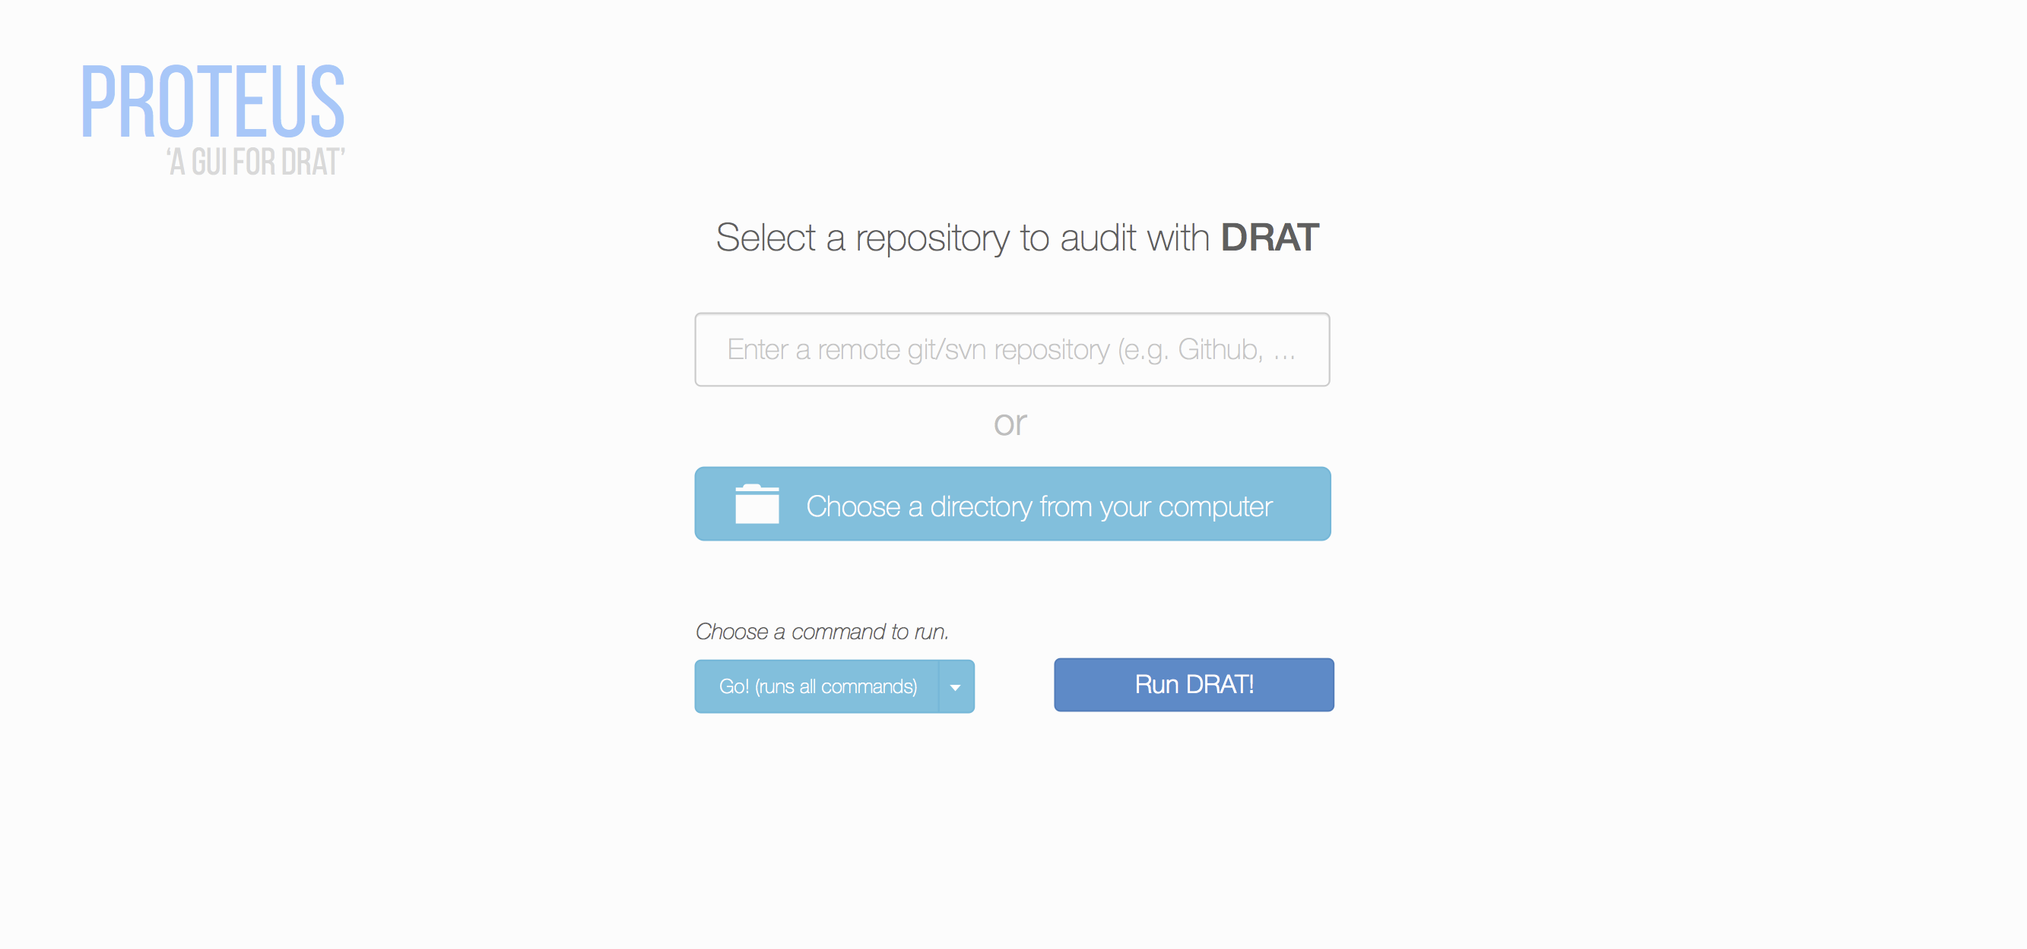
Ongoing Development
DRAT Proteus

Slide 14
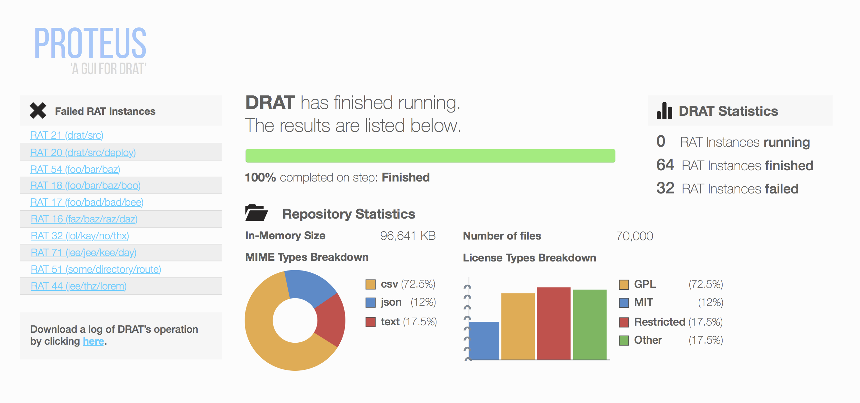
Ongoing Development
DRAT Proteus - https://github.com/chrismattmann/drat/issues/56

Slide 15
Conclusion and Recap
DRAT overcomes the limitations of RAT by
Producing incremental output enabling interactive, improved understanding of how large scale source code license analysis tasks are doing,
Using Apache Tika for automated generation of black and white lists by file type/MIME type, in turn based on the presence of new files can improve Apache Tika
Using Apache Solr to analyze code repositories and search for files, and
Using Apache OODT and M/R to scale out source code license on large code bases.
DRAT is Licensed permissively under the Apache License v2.0

Slide 16
Thank you all… very much Enjoy the remainder of the Conference and Workshop… and of course Lincoln Questions?
Find me/us over on our project list
https://github.com/chrismattmann/drat
lewis.j.mcgibbney@jpl.nasa.gov
@hectorMcSpector

